Slide 2
How to Achieve Optimistic Updates with Blazor and EF Core
Emanuele Bartolesi

Slide 3
What are Optimistic Updates?
Optimistic updates are a technique for
improving the user experience of web applications by updating the UI before the server confirms the changes.

Slide 4
Real World Examples
Google Docs
GitHub
Trello
Slack
Facebook
Twitter
Outlook
E-commerce
Miro
Online Games

Slide 5
Implementation strategy with Blazor
Use a shared data context: share a data context or repository across components to keep data in sync
Implement change tracking: detect changes made by users and other components
Handle conflicts: implement a strategy for resolving conflicts when they occur
Update the user interface: update the UI to reflect changes and conflicts

Slide 6
Demo

Slide 7
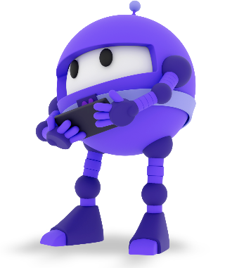
Resources
Download .NET 8 aka.ms/get-dotnet-8
Blazor link
Blazor Tutorial link
EF Core link

Slide 8




Emanuele Bartolesi
//dev.to/kasuken
emanueleb@outlook.com
//dev.to/kasuken
emanueleb@outlook.com
@kasuken
//github.com/kasuken
@kasuken
//twitch.tv/kasuken
@kasuken
//twitch.tv/kasuken
https://links.emanuelebartolesi.com

